Slide 1
Chapter 2
Understanding Objects in Java
Part II

Slide 2
Lecture Outlines
Creating an object
Creating a method
a)User-Defined Methods
  Void methods
    Methods that do not have a return type
  Value-returning methods
    Methods that have a return type
b) Method overloading

Slide 3
Learning Objectives
To describe how objects are returned from methods
To describe how the arguments are passed to the parameters using the pass-by-value scheme
To create user-defined classes and its objects
To create user-defined methods including the method that returns a value and method that receives argument (s) as parameter.
To define overloaded methods and constructors
To create overloading method

Slide 4
Object Declaration
Class Name
This class must be defined before this declaration can be stated.
Object Name
One object is declared here.
Customer myCustomer;
Account customer;
Student jan, jim, jon;
Vehicle car1, car2;
More
Examples
Declaration of an object reference
Notes:
To use an object in a program, we first declare and create an object, and then we send messages to it.
The first step in using an object is to declare it. An object declaration designates the name of an object and the class to which the object belongs to. In this declaration, we are declaring the name myWindow, which we will use to refer to a JFrame object.
Any valid identifier that is not reserved for other uses can be used as an object name. An identifier is a sequence of letters, digits, and the dollar sign with the first one being a letter. We use an identifier to name a class, object, method, and others. No spaces are allowed in an identifier.
Remember that upper- and lowercase letters are distinguished in Java.

Slide 5
Object Creation
Object Name
Name of the object we are creating here.
Class Name
An instance of this class is created.
Argument
No arguments are used here.
myCustomer = new Customer ( ) ;
More
Examples
account1 = new Account( );
jon = new Student(“John Java”);
car1 = new Vehicle( );
assigning an object reference to the object
Notes:
An object declaration simply declares the name (identifier), which we use to refer to an object. The declaration does not create an object. To create the actual object, we need to invoke the new operation.
Make sure you understand the distinction between object declaration and object creation.

Slide 6
Object Declaration vs. Object Creation
1
Customer customer;
customer = new Customer( );
Customer customer;
2
customer = new Customer( );
customer
1. The identifier customer is declared and space is allocated in memory.
1
2. A Customer object is created and the identifier customer is set to refer to it.
2
: Customer
Notes:
This shows the distinction between object declaration and creation by showing the effect of executing the two statements in memory allocation. Notice that the memory space for a Customer object does not happen until the correct new command is executed.

Slide 7
State-of-Memory vs. Program Diagram
customer
customer : Customer
: Customer
State-of-Memory
Notation
Program Diagram
Notation
Notes:
This shows two different dagrams showing the same information. Namely, there’s a Customer object and the name we’re using to refer to it is customer.

Slide 8
Object Creation – cont’d
Customer customer;
customer = new Customer( );
customer = new Customer( );
Customer customer;
customer = new Customer( );
customer = new Customer( );
customer
Created with the first new.
Created with the second new. Reference to the first Customer object is lost.
: Customer
: Customer
Notes:
Is this code fragment valid? Yes, the name and the object itself are two different things. The same name can refer to different objects at different times while the program is running. This example shows the same name pointing to two different objects (at different times, of course).
Since there is no reference to the first Customer object when the second new statement, it will eventually be erased and returned to the system. Remember that when an object is created, a certain amount of memory space is allocated for storing this object. If this allocated but unused space is not returned to the system for other uses, the space gets wasted.
This returning of space to the system is called deallocation, and the mechanism to deallocate unused space is called garbage collection.

Slide 9
Sending a Message to Object
After an object is created, its data can be accessed and its methods invoked using the dot operator(.).
objectRefVar.dataField
- references a data field in the object.
objectRefVar.method(arguments)
- invokes a method on the object.
Notes:
Ada 2 kategori method
1.Method yg dpt pulangkan nilai-→guna return
2.Void method→tak dpt pulangkan nilai

Slide 10
Sending a Message to Object
Object Name
Name of the object to which we are sending a message.
Method Name
The name of the message we are sending.
Argument
The argument we are passing with the message.
myCustomer . setCustomerInfo ( “Ali” ) ;
More
Examples
account.deposit( 200.0 );
student.setName(“john”);
car1.startEngine( );
Notes:
This is the Java syntax for seding a message to an object or a class. In this example, we are sending the setVisible method to myWindow with an argument true, so the window indeed becomes visible. If we want to hide it, then we pass the argument false.
The name of the message we send to an object or a class must be the same as the method’s name, so we use the phrase “calling an object’s method” and “sending a message to an object” interchangeably.

Slide 11
Sending a Message to Object
Example:
Car.colour
- references the colour in Vehicle class.
Car.printColour();
- invokes the printColour() method on
Car.Methods are invoked as operations
on objects.
Notes:
Ada 2 kategori method
1.Method yg dpt pulangkan nilai-→guna return
2.Void method→tak dpt pulangkan nilai

Slide 12
Template for Class Definition
Import Statements
Class Comment
class
{
Class Name
Data Members
Methods
(incl. Constructor)
}
Notes:
This is the template we use when creating programmer-defined classes.

Slide 13
Data Members Definition
  <modifiers> <data type> <name> ;
Modifiers
Data Type
Name
  private String ownerName ;
Note: There’s only one modifier in this example.

Slide 14
Methods Declaration
  <modifier> <return type> <method name> ( <parameters> ){
  <statements>
  }
Modifier
Return Type
Method Name
Parameter
  public void setOwnerName ( String name ) {
  ownerName = name;
  }
Statements

Slide 15
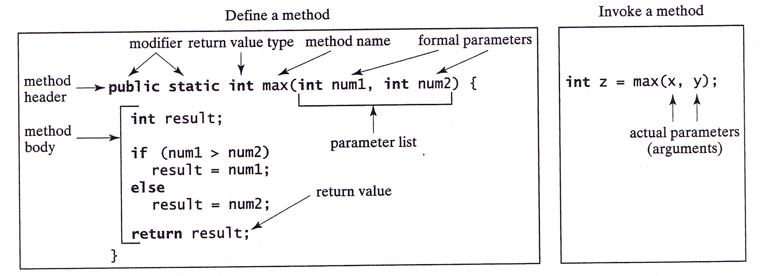
Methods Declaration
A method declaration consists of a method header and a method body.
Notes:
Ada 2 kategori method
1.Method yg dpt pulangkan nilai-→guna return
2.Void method→tak dpt pulangkan nilai

Slide 16
User-defined Methods
Classified into 2 categories
  Void methods
    Methods that do not have a return type
  Value-returning methods (accessor)
    Methods that have a return type
Notes:
Ada 2 kategori method
1.Method yg dpt pulangkan nilai-→guna return
2.Void method→tak dpt pulangkan nilai

Slide 17
Void methods: Method Declaration
Void methods without parameters
  modifier(s) void methodName ()
  {
  statements
  }
Void methods with parameters
  modifier(s) void methodName (formal parameter list)
  {
  statements
  }
Notes:
Void methods without parameters
Methods yg tiada parameter pada header
Void methods with parameters
Methods yg ada parameter pada header (boleh ada lebih dari satu parameter)

Slide 18
Void methods: Method Call
Void methods without parameters
objectRef.methodName();
Void methods with parameter
objectRef.methodName(argument list);

Slide 19
Sample: Method Call (void method-without parameter)
public class Fruit {
private String name,color;
public void setInfo(){
name= "Apple";
color = "red";
}
public void printFruitDetails(){
System.out.println ("Name of the fruit: " + name);
System.out.println ("Color of the fruit: " + color);
}
}
public class TestFruit {
public static void main (String [] args){
Fruit apple=new Fruit ();
apple.setInfo();
apple. printFruitDetails();
}
}
Output:
Name of the fruit: Apple
Color of the fruit: red

Slide 20
Arguments and Parameters
class Sample {
public static void
main(String[] arg) {
Account acct = new Account();
. . .
acct.add(400);
. . .
}
. . .
}
parameter
class Account {
. . .
public void add(double amt) {
balance = balance + amt;
}
. . .
}
argument
An argument is a value we pass to a method
A parameter is a placeholder in the called method to hold the value of the passed argument.

Slide 21
Matching Arguments and Parameters
Demo demo = new Demo( );
int i = 5; int k = 14;
demo.compute(i, k, 20);
The number or arguments and the parameters must be the same
3 arguments
Passing Side
Arguments and parameters are paired left to right
class Demo {
public void compute(int i, int j, double x) {
. . .
}
}
The matched pair must be assignment-compatible (e.g. you cannot pass a double argument to a int parameter)
3 parameters
Receiving Side
Notes:
The following calls are valid
int i, k, m;
i = 12; k = 10; m = 14;
demo.compute(3, 4, 5.5);
demo.compute(i, k, m);
demo.compute(m, 20, 40);
The following calls are not valid
demo.compute(2, 4);
demo.compute(14.0, 2, 3.0);

Slide 22
Arguments and Parameters – Memory Allocation
Separate memory space is allocated for the receiving method.
i
5
i
5
k
14
j
14
20
x
20.0
Values of arguments are passed into memory allocated for parameters.
Passing Side
Receiving Side
Literal constant
has no name
Notes:
The following calls are valid
int i, k, m;
i = 12; k = 10; m = 14;
demo.compute(3, 4, 5.5);
demo.compute(i, k, m);
demo.compute(m, 20, 40);
The following calls are not valid
demo.compute(2, 4);
demo.compute(14.0, 2, 3.0);

Slide 23

Parameter Passing – Key Points
1. Arguments are matched to the parameters from left to right.The data type of an argument must be assignment-compatible with the data type of the matching parameter.
2. The number of arguments in the method call must match the number of parameters in the method definition.
3. Parameters and arguments do not have to have the same name.
4. Local copies, which are distinct from arguments,are created even if the parameters and arguments share the same name.
5. Parameters are input to a method, and they are local to the method.Changes made to the parameters will not affect the value of corresponding arguments.

Slide 24
Method with Parameters - Sample
public class Fruit {
private String name,color;
public void setInfo(String nm, String colr){
name= nm;
color = colr;
}
public void printFruitDetails(){
System.out.println ("Name of the fruit: " + name);
System.out.println ("Color of the fruit: " + color);
}
}
public class TestFruit {
public static void main (String [] args){
Fruit apple=new Fruit ();
apple.setInfo("Apple","red");
apple. printFruitDetails();
}
}
Output:
Name of the fruit: Apple
Color of the fruit: red

Slide 25
Value – Returning Method
To use these methods in programs, we must know
  Name of the method
  Number of parameters (if any)
  Data type of each parameter
  Data type of the value computed (value returned) by the method (called the type of the method

Slide 26
Value – Returning Method: Method Declaration
modifier(s) returnType methodName (formal parameter list)
{
statements
}
Modifier(s)
  Indicates the visibility of the method
returnType
  Type of value that the method return
methodName
  Name of the method
Formal parameter list
  Variable declared in the method heading
Notes:
Modifier(s)
Ada beberapa jenis…public, private,protected, static, abstract dan final (akan diterangkan dlm part 2)
returnType
Juga dikenali sbg type of the value-returning method
Statements
Berada dlm curly braces

Slide 27
Value – Returning Method: Method Call
Syntax to call a value-returning method
  returnValue = methodName(argument list);
Notes:
Sintak untuk memanggil method yang boleh pulangkan nilai (mesti ada parameter semasa panggilan dilakukan)

Slide 28
Return Statement
Value-returning method uses a return statement to return its value; it passes a value outside the method.
Syntax:return statement
  return expr;
Where expr can be:
  Variable, constant value or expression

Slide 29
Sample: Value – Returning Method
public class Fruit {
private String name,color;
public void setInfo(){
name= "Apple";
color = "red";
}
public String getFruitName(){
return name;
}
public String getFruitColor(){
return color;
}
}
public class TestFruit {
public static void main (String [] args){
Fruit apple=new Fruit();
String fruitName,fruitColor;
apple.setInfo();
fruitName=apple.getFruitName();
fruitColor=apple.getFruitColor();
System.out.println("Name of the Fruit: " + fruitName);
System.out.println("Color of the Fruit: " + fruitColor);
}
}
Output:
Name of the fruit: Apple
Color of the fruit: red

Slide 30
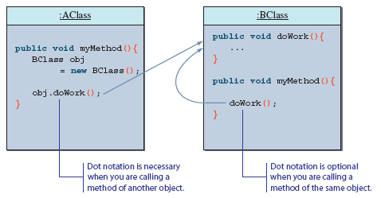
Calling Methods of the Same Class
So far, we have been calling a method of another class (object).
It is possible to call method of a class from another method of the same class.
  in this case, we simply refer to a method without dot notation

Slide 31
Method Overloading
In java, within a class, several methods can have the same name. We called method overloading
Two methods are said to have different formal parameter lists:
  If both methods have a different number of formal parameters
  If the number of formal parameters is the same in both methods, the data type of the formal parameters in the order we list must differ in at least one position
It is useful when you need to perform similar method on different types of data.

Slide 32
Method Overloading
Example:
  public void methodABC()
  public void methodABC(int x, double y)
  public void methodABC(double x, int y)
  public void methodABC(char x, double y)
  public void methodABC(String x,int y)
Notes:
Method methodABC() merupakan satu contoh method overloading dalam satu kelas

Slide 33
Sample: Method Overloading
public class Fruit {
private String name,color;
private double diameter;
public void setInfo(String nm,String colr){
name= nm;
color=colr;
}
public void setInfo(String nm,String colr,double diamtr){
name= nm;
color=colr;
diameter=diamtr;
}
public void printFruitInfo1(){
System.out.println("Name of the Fruit: " + name);
System.out.println("Color of the Fruit: " + color);
}
public void printFruitInfo2(){
System.out.println("Name of the Fruit: " + name);
System.out.println("Color of the Fruit: " + color);
System.out.println("Diameter of the Fruit: " + diameter);
}
}

Slide 34
public class TestFruit {
public static void main (String [] args){
Fruit apple1=new Fruit ();
apple.setInfo("Apple","red");
apple.printFruitInfo1();
System.out.println();
Fruit apple2=new Fruit ();
apple2.setInfo("Apple","green",8.5);
apple2.printFruitInfo2();
}
}
Output:
Name of the Fruit: Apple
Color of the Fruit: red
Name of the Fruit: Apple
Color of the Fruit: green
Diameter of the Fruit: 8.5

Slide 35
Q & A

